Slide 1
Hypothesis Testing I
Statistical Data Analysis, 2023

Slide 2
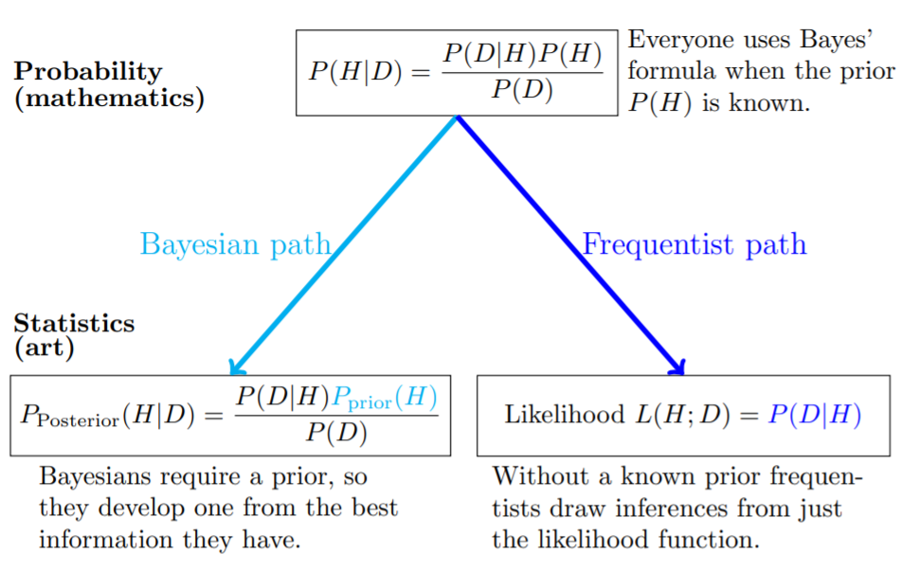
Bayesian vs Frequentist
Frequentist:
For a specific unknown event, a frequentist will consider it either occur or not occur.
He/she does not place a prior on the event.

Slide 3
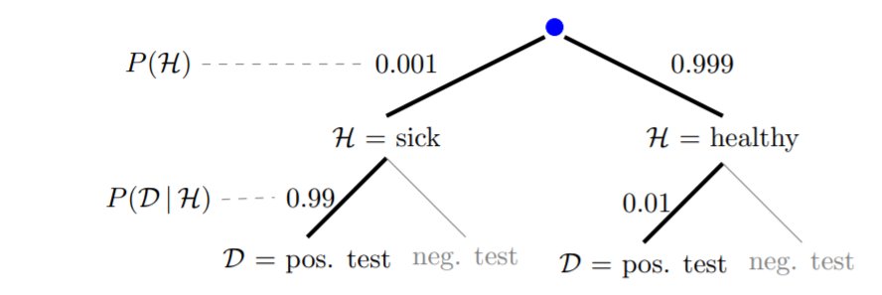
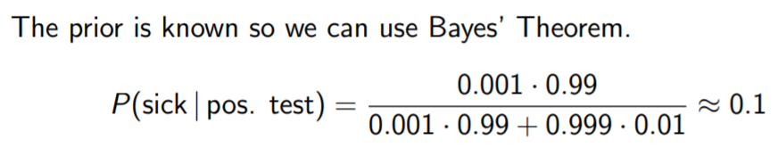
Bayesian vs Frequentist
Testing for a disease:

Slide 4
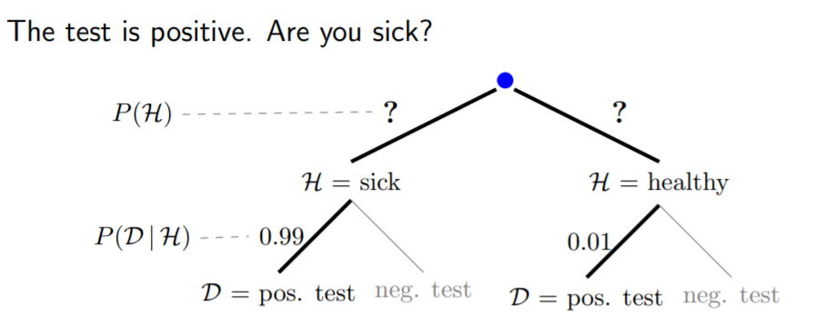

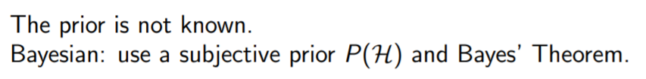
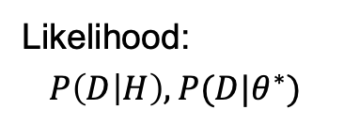
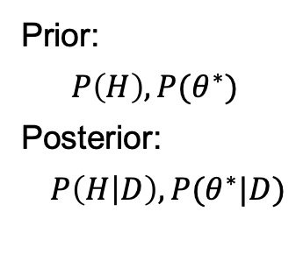
Bayesian vs Frequentist
Frequentist
Prior:
$$P\left(H\right), P(θ^{∗})$$
Posterior: $P\left(H | D\right),P(θ^{∗}|D)$
Likelihood:
$$P\left(D | H\right), P(D|θ^{∗})$$
Notes:
We can talk about the probability of a parameter in Bayesian statistics.

Slide 5
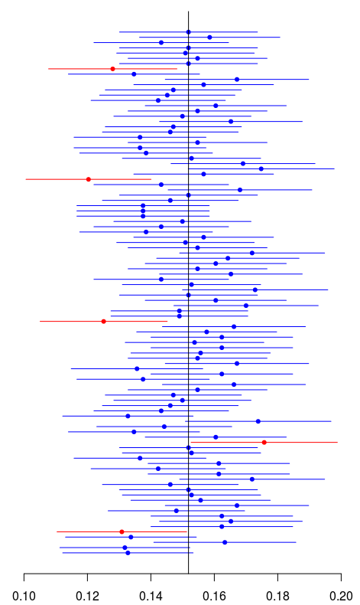


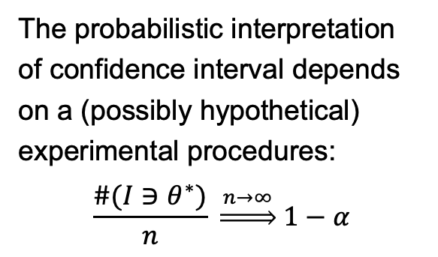
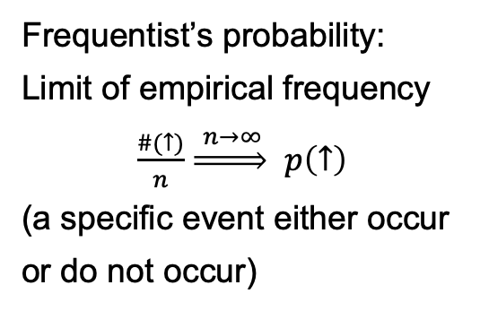
Frequentist
Frequentist’s probability:
Limit of empirical frequency
$\frac{\#(↑)}{n} \underset{⇒}{ n→∞ }$ $p\left(↑\right)$
(a specific event either occur or do not occur)
Difficulty:
What’s the “probability” that it will rain tomorrow?
(cannot repeat the experiment)
The probabilistic interpretation of confidence interval depends on a (possibly hypothetical) experimental procedures:
$$\frac{\#(I∋θ^{∗})}{n} \underset{⇒}{ n→∞ } 1−α$$
Notes:
Frequentist has difficulties when assigning probability to a single event.

Slide 6
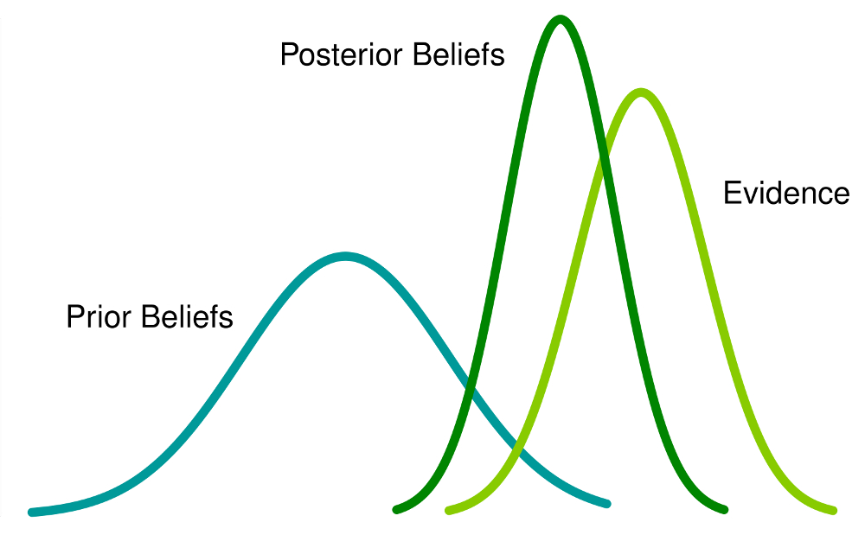
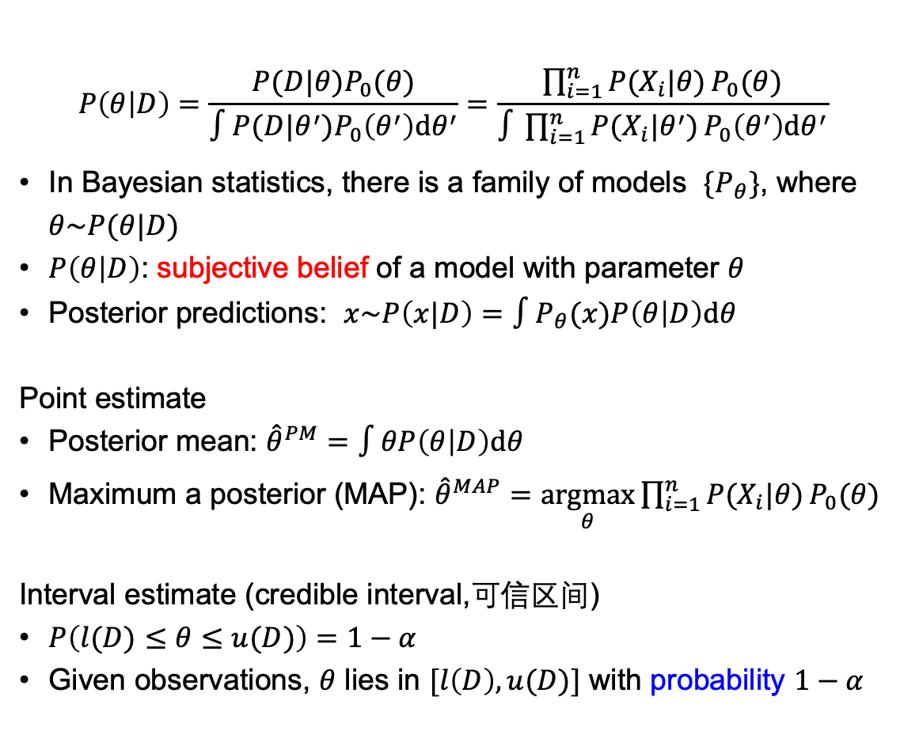
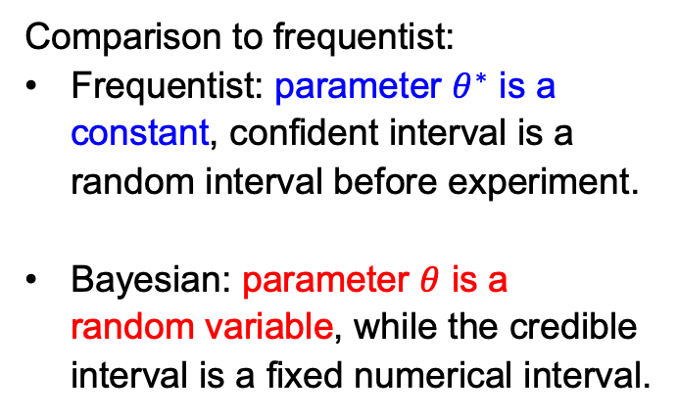
Bayesian (Optional)
$$P\left(θ | D\right)=\frac{P(D|θ)P_{0}(θ)}{∫P(D|θ^{′})P_{0}\left(θ^{′}\right)dθ^{′}}=\frac{\prod_{i=1}^{n}{P(X_{i}|θ)}P_{0}(θ)}{∫\prod_{i=1}^{n}{P(X_{i}|θ^{′})}P_{0}\left(θ^{′}\right)dθ^{′}}$$
In Bayesian statistics, there is a family of models $\{P_{θ}\}$, where $θ\sim P(θ|D)$
$P\left(θ | D\right)$: subjective belief of a model with parameter $θ$
Posterior predictions: $x\sim P\left(x|D\right)=∫P_{θ}(x)P\left(θ | D\right)dθ$
Point estimate
Posterior mean: ${\hat{θ}}^{PM}=∫θP\left(θ | D\right)dθ$
Maximum a posterior (MAP): ${\hat{θ}}^{MAP}=\underset{θ}{argmax}\prod_{i=1}^{n}{P(X_{i}|θ)}P_{0}(θ)$
Interval estimate (credible interval,可信区间)
$P\left(l(D)≤θ≤u(D)\right)=1−α$
Given observations, $θ$ lies in $[l\left(D\right),u(D)]$ with probability $1−α$
Comparison to frequentist:
Frequentist: parameter $θ^{∗}$ is a constant, confident interval is a random interval before experiment.
Bayesian: parameter $θ$ is a random variable, while the credible interval is a fixed numerical interval.

Slide 7


投票
最多可选1项
For natural science which deals with the objective world, do you think it makes sense to use the Bayesian approach for data analyses?
A
Yes
B
No
提交

Slide 8


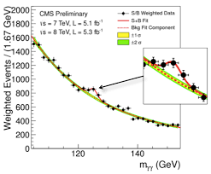

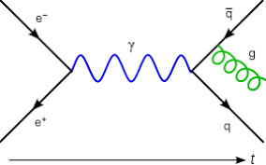
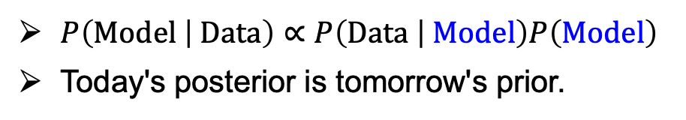

Perspective
$$P\left(Reality | Data\right)?$$
Reality
Data
Fact:
Bayesian statistics is widely used in particle physics research in search of the most fundamental particles.
Model / Theory
$P\left(Model | Data\right)∝P\left(Data | Model\right)P\left(Model\right)$
Today's posterior is tomorrow's prior.

Slide 9
Frequentist’s
Null Hypothesis Significance Testing (NHST)

Slide 10
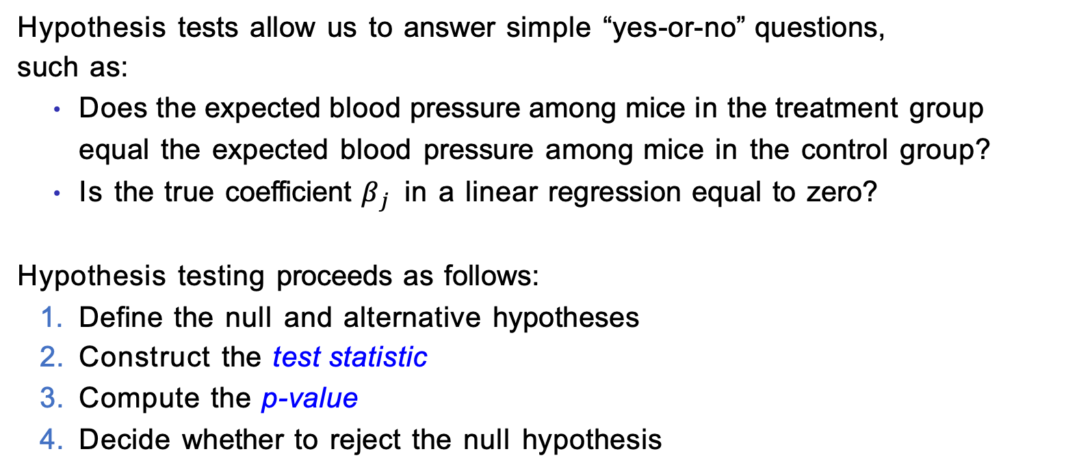
A Quick Review of Hypothesis Testing
Hypothesis tests allow us to answer simple “yes-or-no” questions, such as:
Does the expected blood pressure among mice in the treatment group equal the expected blood pressure among mice in the control group?
Is the true coefficient $β_{j}$ in a linear regression equal to zero?
Hypothesis testing proceeds as follows:
Define the null and alternative hypotheses
Construct the test statistic
Compute the p-value
Decide whether to reject the null hypothesis

Slide 11
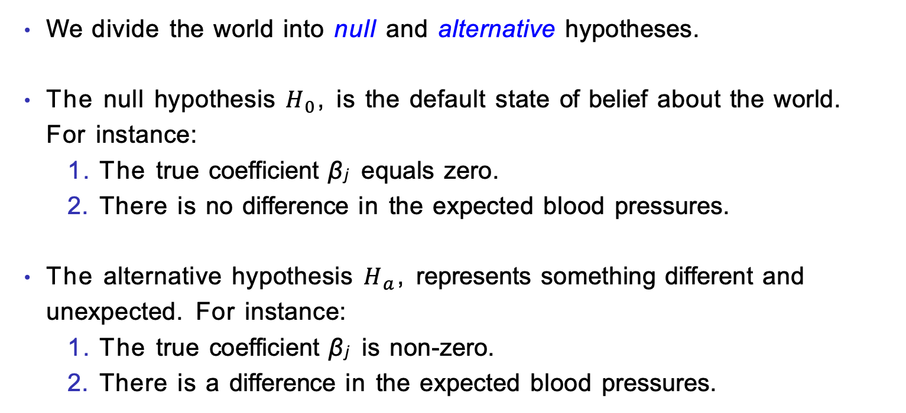
1. Define the Null and Alternative Hypotheses
We divide the world into null and alternative hypotheses.
The null hypothesis $H_{0}$, is the default state of belief about the world. For instance:
The true coefficient β_{j} equals zero.
There is no difference in the expected blood pressures.
The alternative hypothesis $H_{a}$, represents something different and unexpected. For instance:
The true coefficient β_{j} is non-zero.
There is a difference in the expected blood pressures.

Slide 12
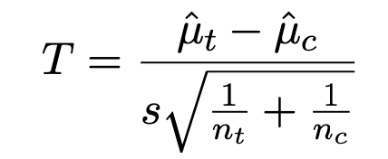
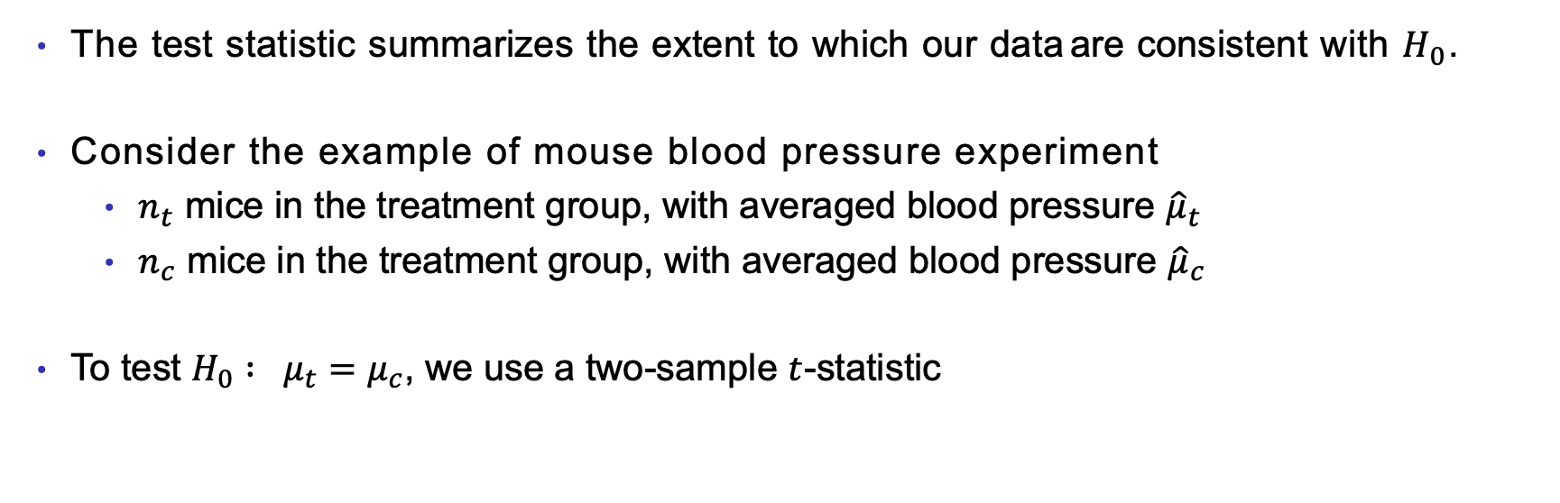
2. Construct the Test Statistic
The test statistic summarizes the extent to which our data are consistent with $H_{0}$.
Consider the example of mouse blood pressure experiment
$n_{t}$ mice in the treatment group, with averaged blood pressure ${\hat{μ}}_{t}$
$n_{c}$ mice in the treatment group, with averaged blood pressure ${\hat{μ}}_{c}$
To test $H_{0} : μ_{t}=μ_{c}$, we use a two-sample $t$-statistic

Slide 13
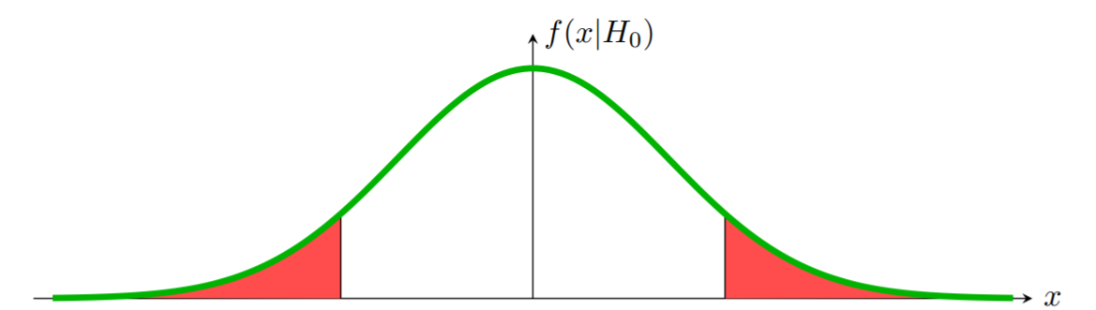
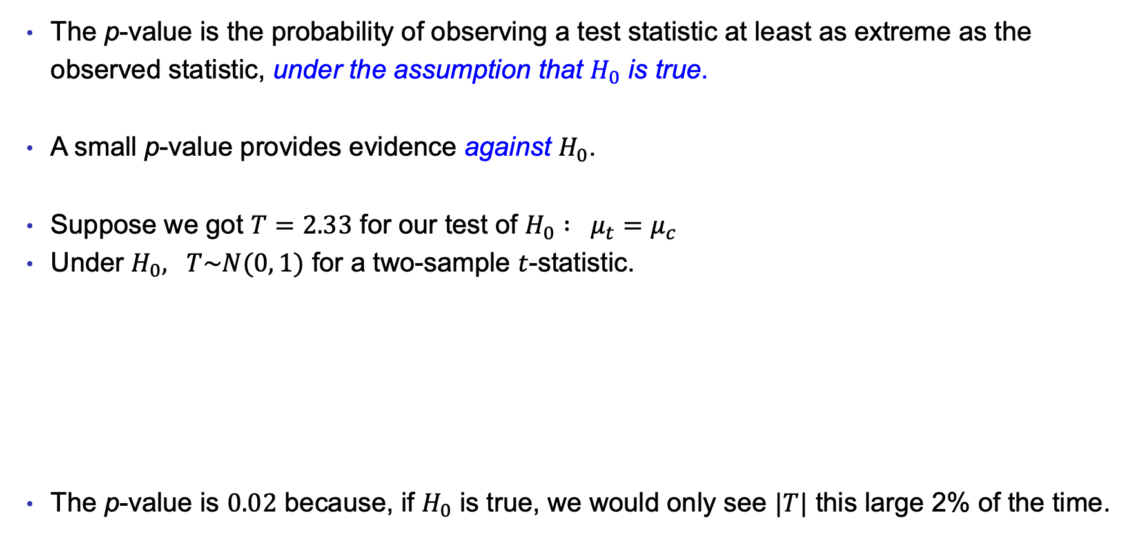
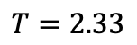
3. Compute the p-value
The p-value is the probability of observing a test statistic at least as extreme as the observed statistic, under the assumption that $H_{0}$ is true.
A small p-value provides evidence against $H_{0}$.
Suppose we got $T=2.33$ for our test of $H_{0} : μ_{t}=μ_{c}$
Under $H_{0}, T\sim N(0, 1)$ for a two-sample $t$-statistic.
The p-value is $0.02$ because, if $H_{0}$ is true, we would only see $|T|$ this large 2% of the time.
$$T=2.33$$

Slide 14
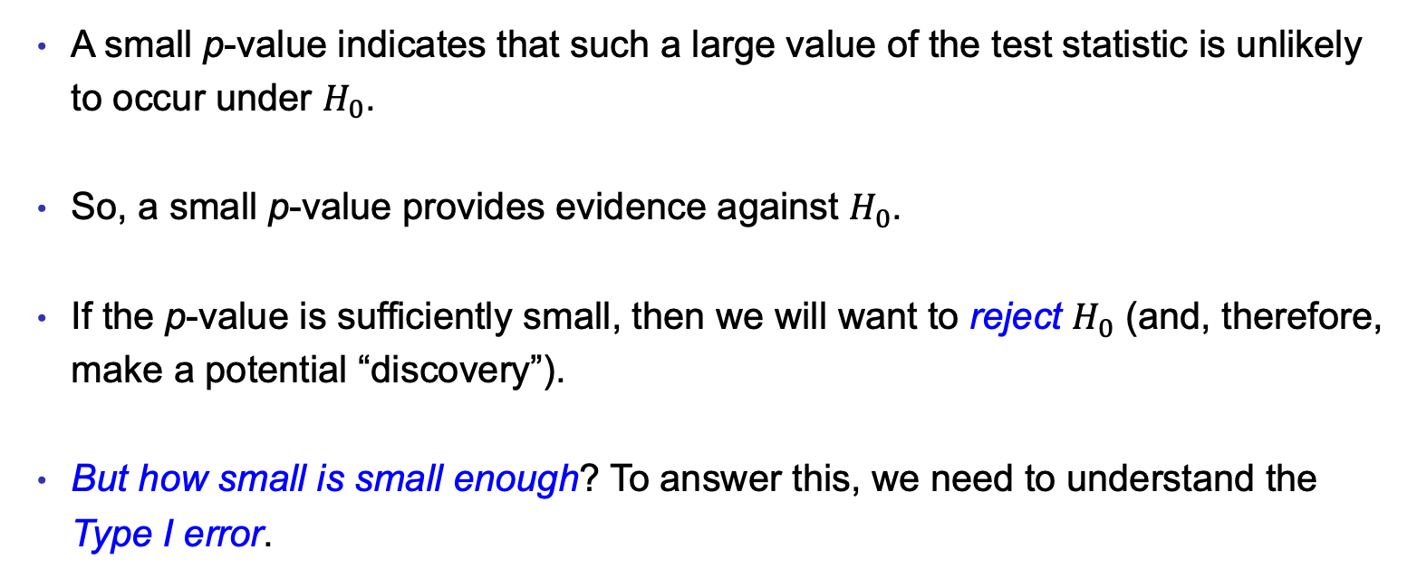
4. Decide Whether to Reject $H_{0}$, Part 1
A small p-value indicates that such a large value of the test statistic is unlikely to occur under $H_{0}$.
So, a small p-value provides evidence against $H_{0}$.
If the p-value is sufficiently small, then we will want to reject $H_{0}$ (and, therefore, make a potential “discovery”).
But how small is small enough? To answer this, we need to understand the Type I error.

Slide 15
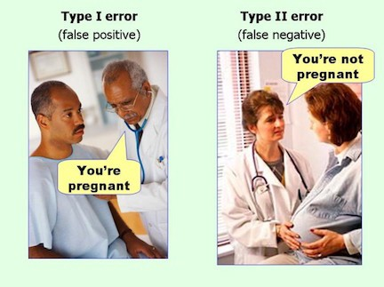
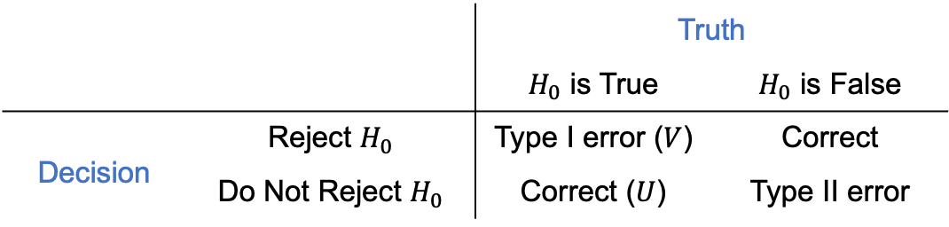
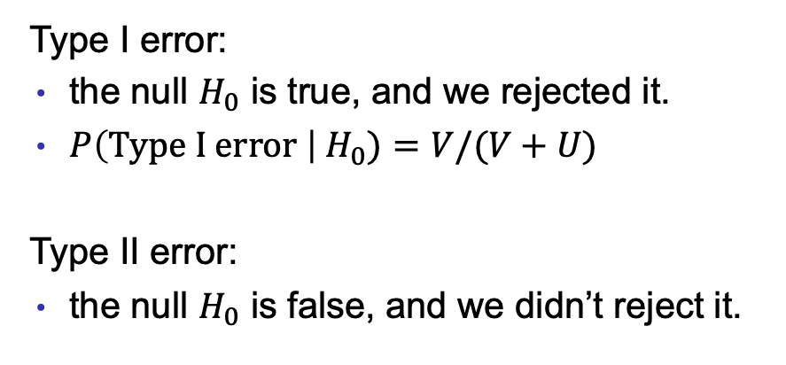
4. Decide Whether to Reject $H_{0}$, Part 2
 |  | Truth
 |  | $H_{0}$ is True | $H_{0}$ is False
Decision | Reject $H_{0}$ | Type I error ($V$) | Correct
 | Do Not Reject $H_{0}$ | Correct ($U$) | Type II error
Type I error:
the null $H_{0}$ is true, and we rejected it.
$P\left(Type I error \right| H_{0})=V/(V+U)$
Type II error:
the null $H_{0}$ is false, and we didn’t reject it.
Notes:
Assume m replicated experiment here.

Slide 16
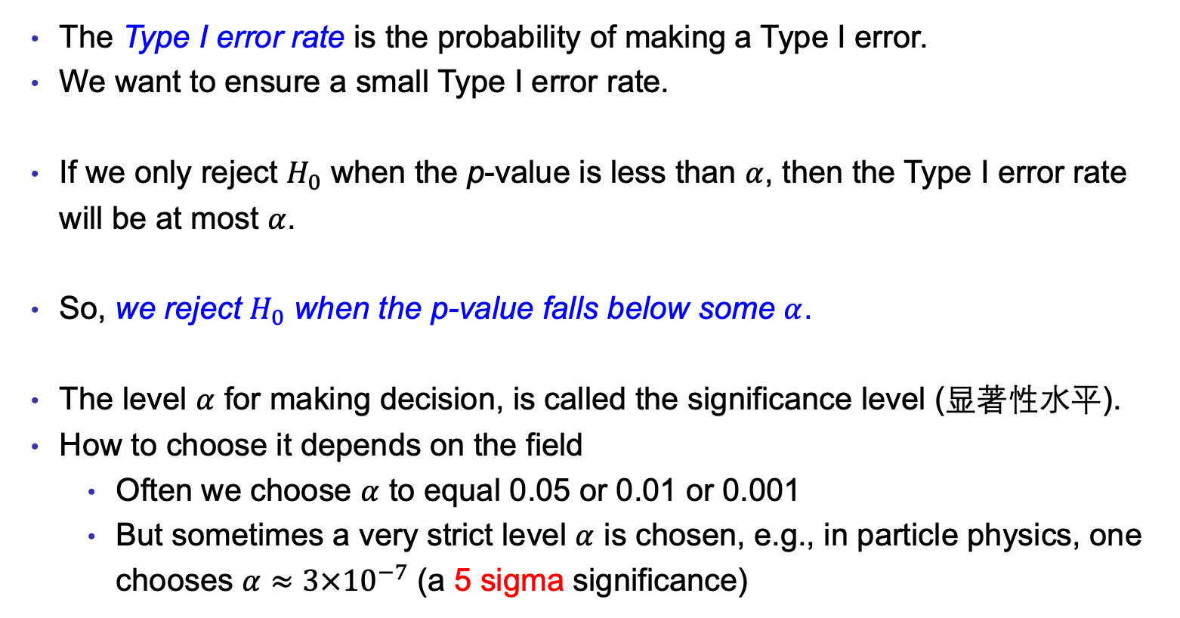
4. Decide Whether to Reject $H_{0}$, Part 3
The Type I error rate is the probability of making a Type I error.
We want to ensure a small Type I error rate.
If we only reject $H_{0}$ when the p-value is less than $α$, then the Type I error rate will be at most $α$.
So, we reject $H_{0}$ when the p-value falls below some $α$.
The level $α$ for making decision, is called the significance level (显著性水平).
How to choose it depends on the field
Often we choose $α$ to equal 0.05 or 0.01 or 0.001
But sometimes a very strict level $α$ is chosen, e.g., in particle physics, one chooses $α≈3×{10}^{−7}$ (a 5 sigma significance)

Slide 17

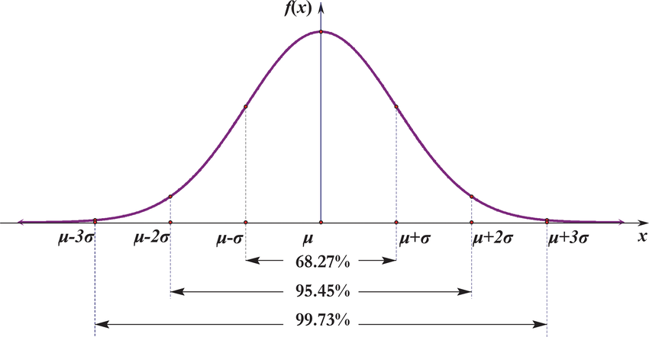
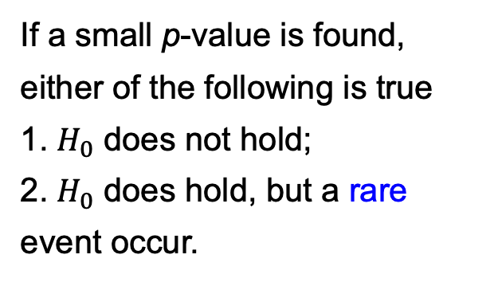
Choice of $α$
If a small p-value is found, either of the following is true
1. $H_{0}$ does not hold;
2. $H_{0}$ does hold, but a rare event occur.
“…the anomaly generated considerable interest in the scientific community, including about 500 theoretical studies.”

Slide 18
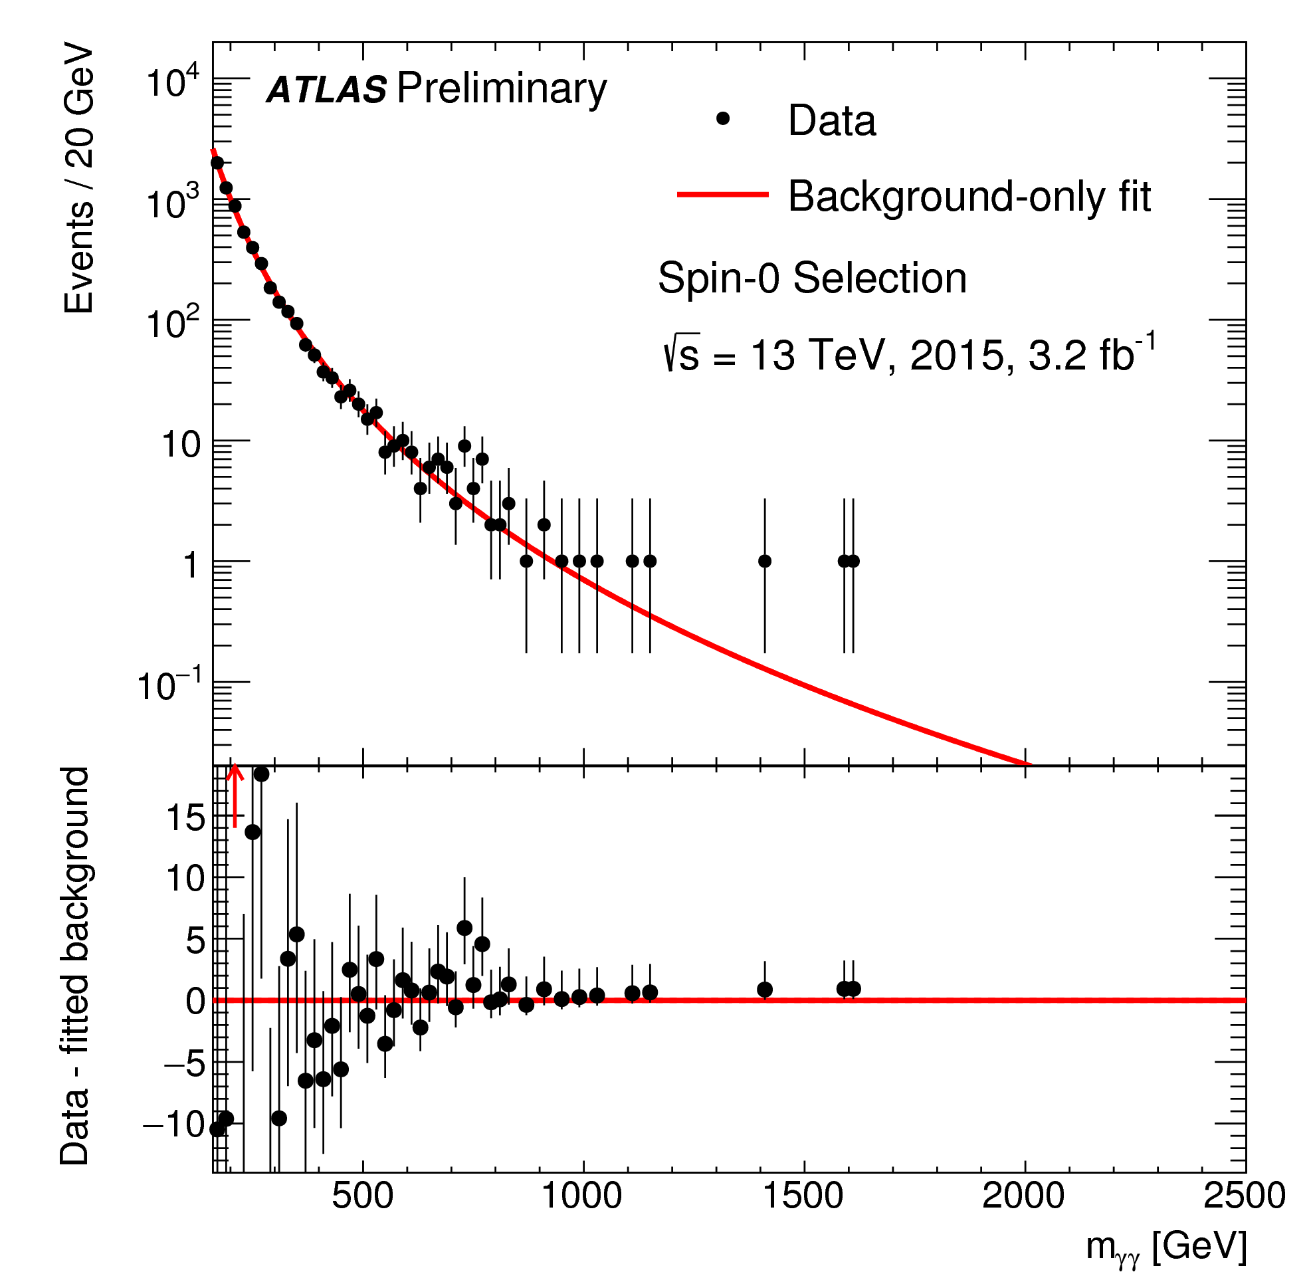
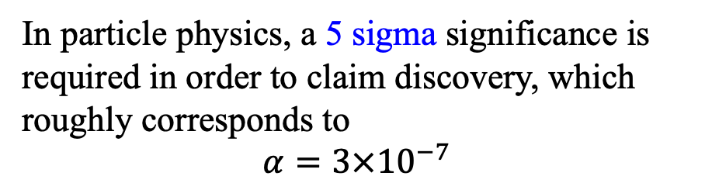
After more data is collected…
Choice of $α$
“…A deviation from the Standard Model background-only hypothesis corresponding to 3.4 standard deviations is observed in the 2015 data for a resonance mass hypothesis of 730 GeV. No significant excess at such mass over the background expectation is observed in the 2016 data. The global significance is estimated to be less than one standard deviation.”
In particle physics, a 5 sigma significance is required in order to claim discovery, which roughly corresponds to
$$α=3×{10}^{−7}$$
Notes:
Big data in big science.

Slide 19

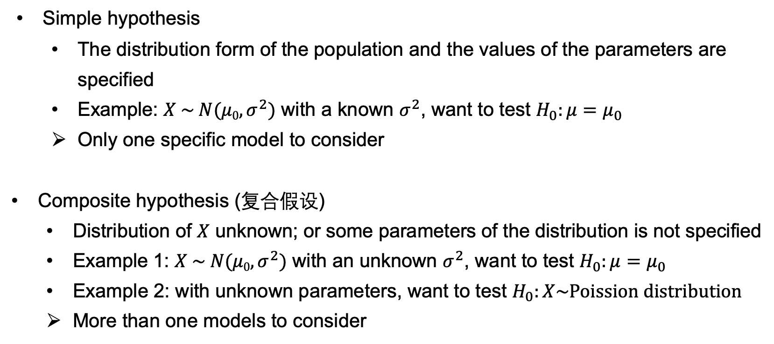
Types of Null Hypothesis
Simple hypothesis
The distribution form of the population and the values of the parameters are specified
Example: $X \sim N(μ0, σ^{2})$ with a known $σ^{2}$, want to test $H_{0}:μ=μ_{0}$
Only one specific model to consider
Composite hypothesis (复合假设)
Distribution of $X$ unknown; or some parameters of the distribution is not specified
Example 1: $X \sim N(μ0, σ^{2})$ with an unknown $σ^{2}$, want to test $H_{0}:μ=μ_{0}$
Example 2: with unknown parameters, want to test $H_{0}:X\sim Poission distribution$
More than one models to consider

Slide 20
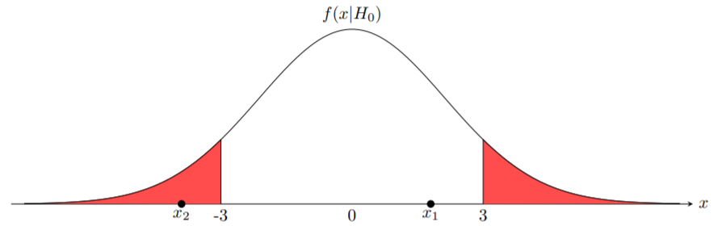
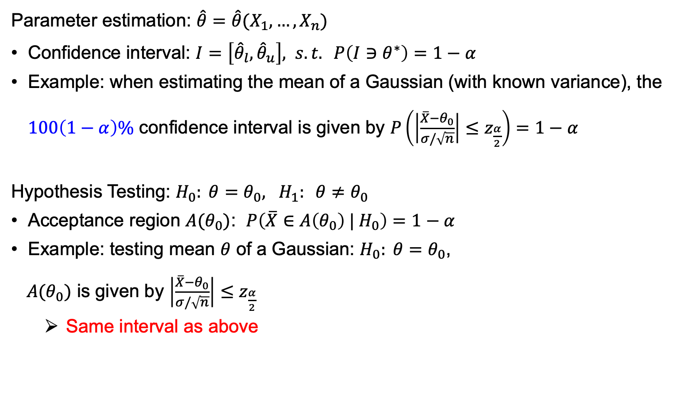
Confidence Interval and (Two-sided) Hypothesis Testing
Parameter estimation: $\hat{θ}=\hat{θ}(X_{1},…, X_{n})$
Confidence interval: $I=\left[{\hat{θ}}_{l},{\hat{θ}}_{u}\right], s.t. P\left(I∋θ^{∗}\right)=1−α$
Example: when estimating the mean of a Gaussian (with known variance), the $100\left(1−α\right)\%$ confidence interval is given by $P\left(\left|\frac{\overline{X}−θ_{0}}{σ/\sqrt{n}}\right|≤z_{\frac{α}{2}}\right)=1−α$
Hypothesis Testing: $H_{0}: θ=θ_{0}, H_{1}: θ≠θ_{0}$
Acceptance region $A(θ_{0})$: $P\left(\overline{X}∈A\left(θ_{0}\right) | H_{0}\right)=1−α$
Example: testing mean $θ$ of a Gaussian: $H_{0}: θ=θ_{0}$,
$A(θ_{0})$ is given by $\left|\frac{\overline{X}−θ_{0}}{σ/\sqrt{n}}\right|≤z_{\frac{α}{2}}$
Same interval as above
Notes:
Fixing Xbar, the condition of the confidence interval defines the interval about theta.
The condition of the hypothesis test defines a theta_0 which satisfies this condition.
Therefore: If theta_0 is not within the (1 - alpha)-confidence interval constructed by Xbar, then H0 is rejected at the alpha level.

Slide 21
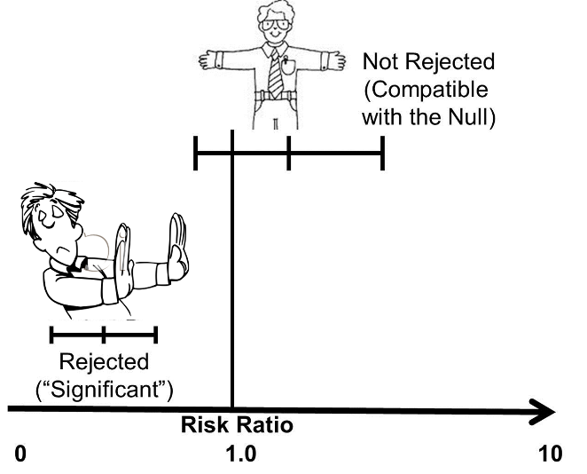

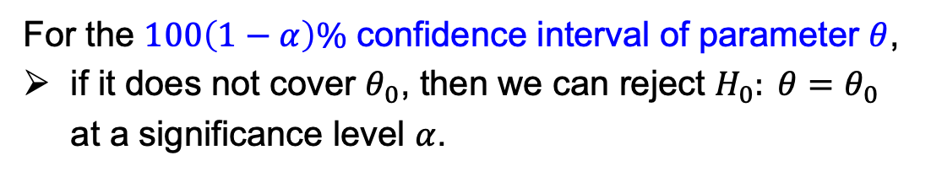
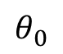
Confidence Interval and (Two-sided) Hypothesis Testing
$$θ_{0}$$
For the $100\left(1−α\right)\%$ confidence interval of parameter $θ$,
if it does not cover $θ_{0}$, then we can reject $H_{0}: θ=θ_{0}$ at a significance level $α$.

Slide 22
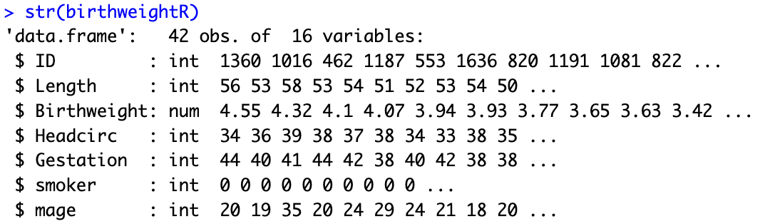
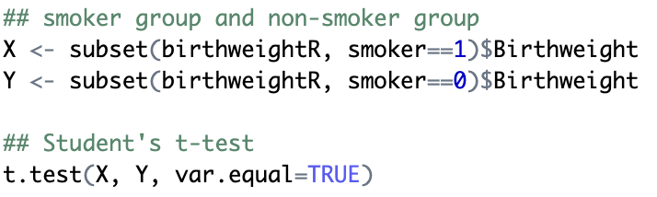
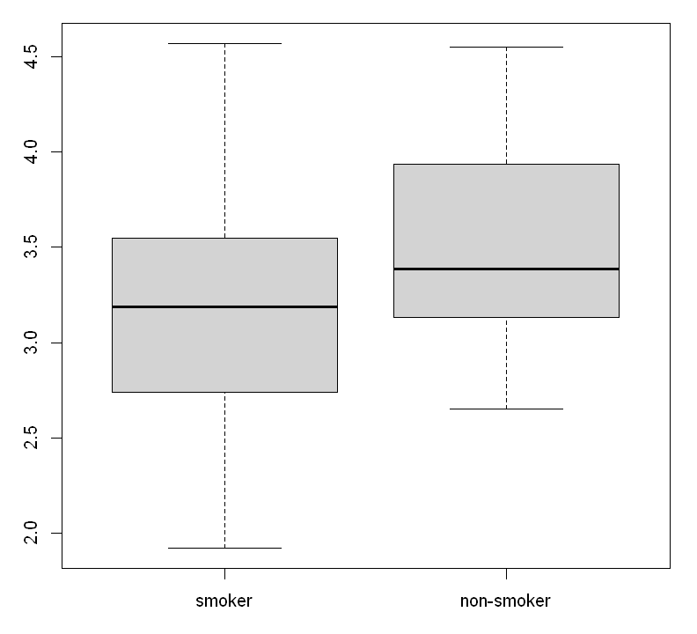
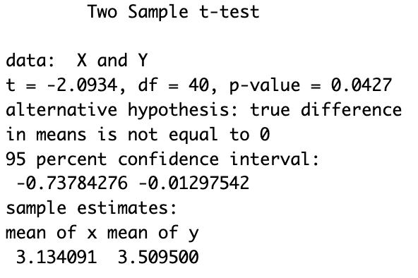

p-value in Practice – Two Sample t-Test
Example: a data set containing information on new born babies and their parents
Interests in Birthweight
…
Two sample $t$-test
$$H_{0} :μ_{X}=μ_{Y}$$
Remind: need the Gaussian distribution assumption for the p-value to make sense.

Slide 23
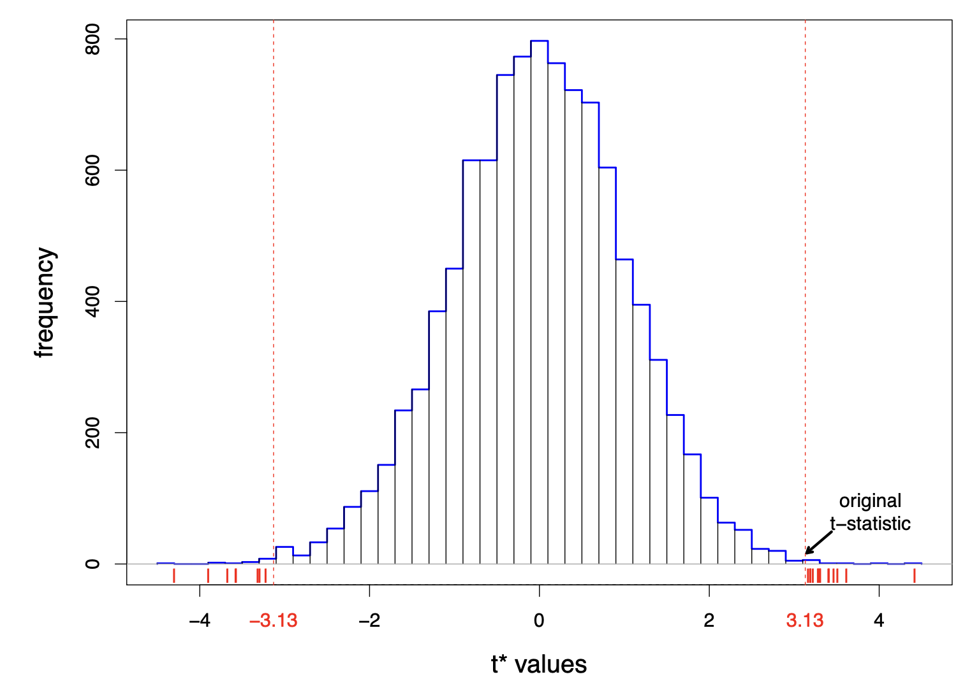
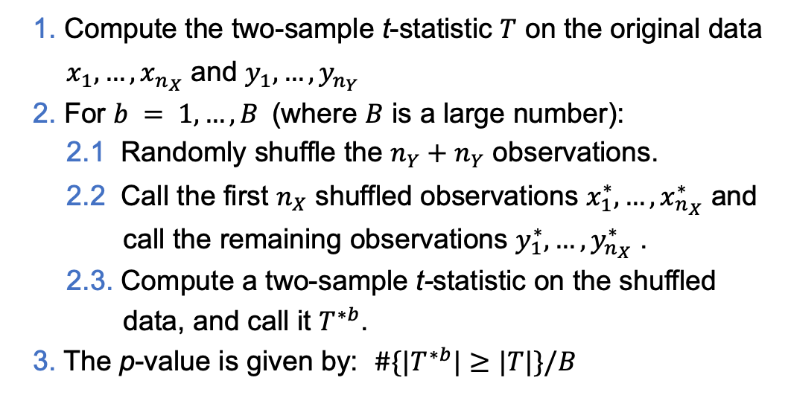
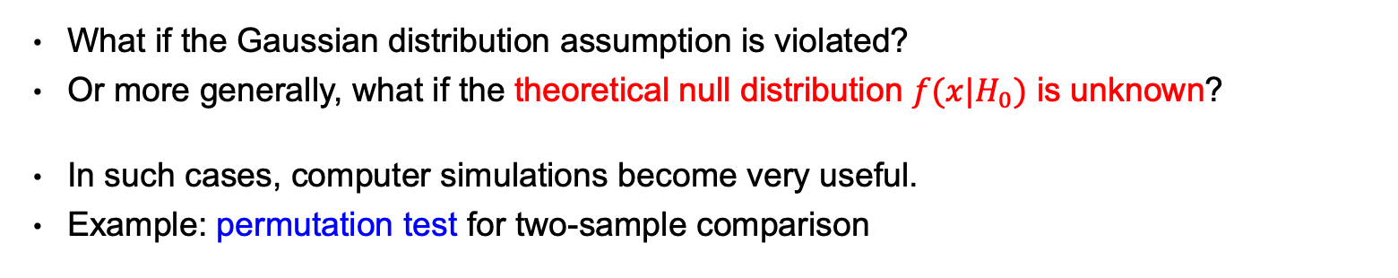
p-value in Practice – Re-sampling Approach
What if the Gaussian distribution assumption is violated?
Or more generally, what if the theoretical null distribution $f(x|H_{0})$ is unknown?
In such cases, computer simulations become very useful.
Example: permutation test for two-sample comparison
1. Compute the two-sample t-statistic $T$ on the original data $x_{1},…, x_{n_{X}}$ and $y_{1},…, y_{n_{Y}}$
2. For $b = 1, …, B$(where $B$ is a large number):
2.1 Randomly shuffle the $n_{Y}+n_{Y}$ observations.
2.2 Call the first $n_{X}$ shuffled observations $x_{1}^{∗},…, x_{n_{X}}^{∗}$ and call the remaining observations $y_{1}^{∗},…, y_{n_{X}}^{∗}$ .
2.3. Compute a two-sample t-statistic on the shuffled data, and call it $T^{∗b}$.
3. The p-value is given by: $\#\{|T^{∗b}|≥|T|\}/B$

Slide 24
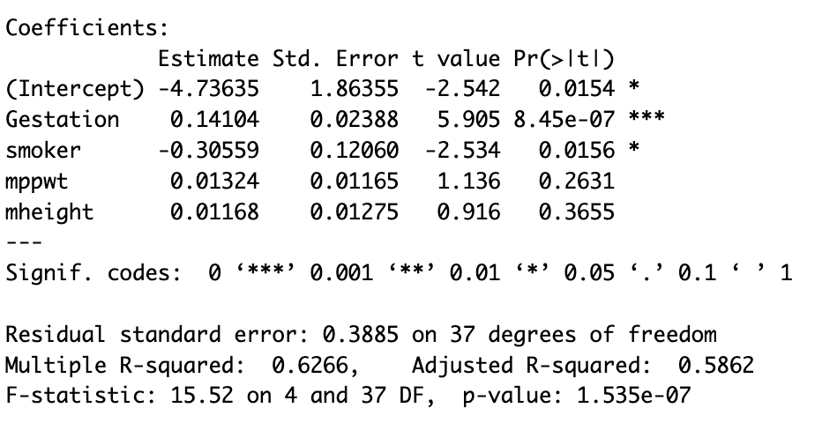
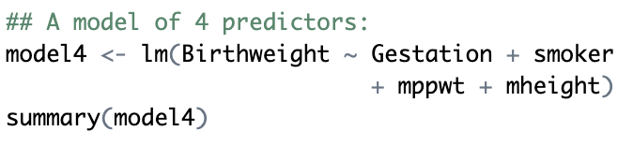

p-value in Practice – Linear Regression
Example: a data set containing information on new born babies and their parents
Interests in Birthweight
…
Linear regression
$$H_{0} :β_{j}=0$$
Remind: need the Gaussian noise assumption for these p-values to make sense.

Slide 25
Caveats of p-value

Slide 26
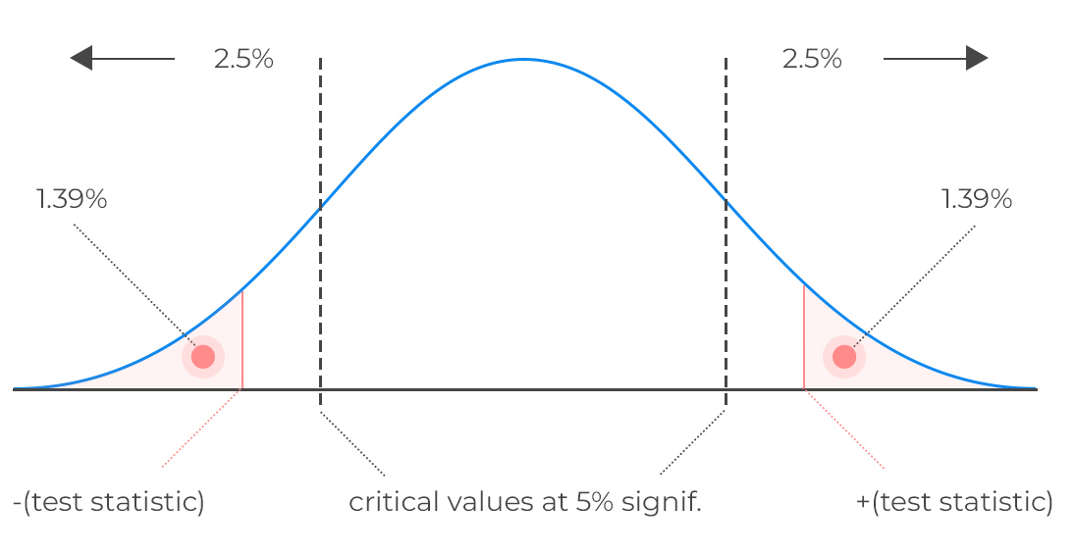
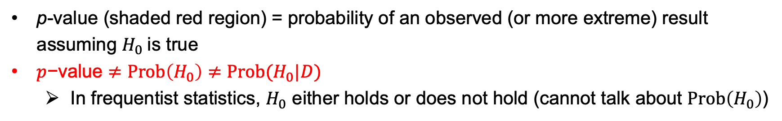

More on p-value (Frequentist)
If a small p-value is found, either of the following is true
1. $H_{0}$ does not hold;
2. $H_{0}$ does hold, but a rare event occur.
p-value (shaded red region) = probability of an observed (or more extreme) result assuming $H_{0}$ is true
$p\text{−}\text{value}≠Prob\left(H_{0}\right)≠Prob(H_{0}|D)$
In frequentist statistics, $H_{0}$ either holds or does not hold (cannot talk about $Prob\left(H_{0}\right)$)

Slide 27
单选题
1分
Do you think whether p-value is a number or a random variable？
A
Number
B
Random variable
C
Depending on before or after the experiment
提交
Notes:
Answer: C

Slide 28
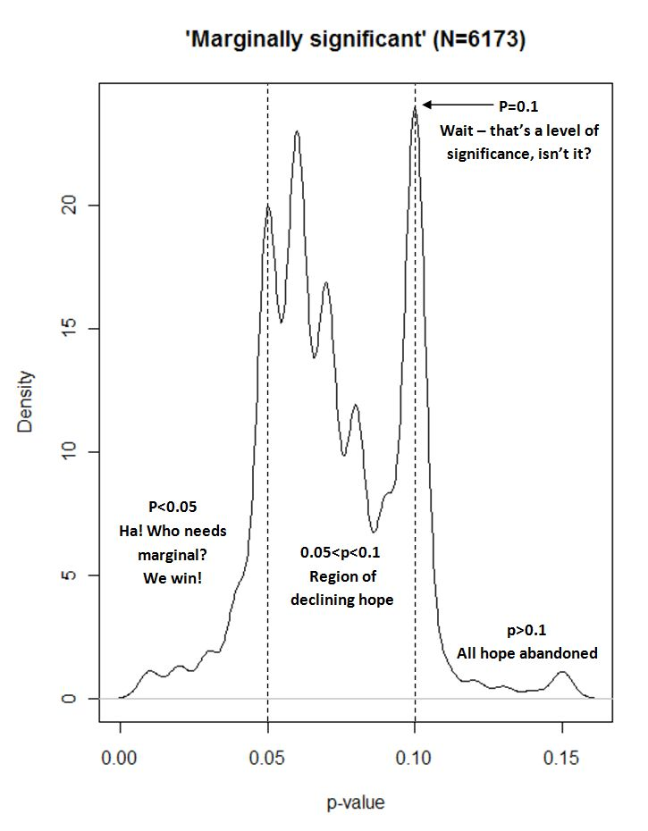

Caveats of NHST and p-value
NHST is so successful that it becomes the de facto standard for claiming scientific discovery.
However, many misuses also arise…
E.g., to chase a (statistical) significance result, possibly by cherry-picking, p-hacking, etc.
Google Scholar search:
“Marginally significant (P=0.0*”
18,893 articles
https://mchankins.wordpress.com/
Goodhart's law:
“When a measure becomes a target, it ceases to be a good measure.”

Slide 29


Caveats of NHST and p-value
There are also many misconceptions about significance and p-value.
Example:
Original study:
View from the media:
“…a low-fat dietary pattern did not result in a statistically significant reduction in invasive breast cancer…”
The term “significance” can be very misleading, in particular to the general public.
The dichotomy to “accept or reject” a hypothesis also creates an illusion of “proof or disproof”.
Notes:
Decide to reject H0: does not mean we have proved that H0 is wrong (still have chance to make Type I error).
Decide not to reject H0: does not mean we have proved and accepted H0 (still have chance to make Type II error).

Slide 30

Caveats of NHST and p-value
Much less obvious misconceptions exist, even for those with some training in statistics
1. If p=0.05, the null hypothesis has a 5% chance of being true.
p-value is not about probability of the hypothesis (in frequentist’s NHST).
…
3. A statistically significant finding is practically important.
The p-value carries no information about the magnitude of an effect.
…
“The most serious … is the false belief that the probability of a conclusion being in error can be calculated from the data in a single experiment, without reference to external evidence or plausibility of any underlying mechanism.”
Notes:
Some misconceptions are very subtle; read the article for more details.

Slide 31

Some Responses – Confidence Interval
Report the confidence interval, in addition to p-value
Though equivalent to hypothesis testing, the interval estimation can be more intuitive than a p-value.
Also a reminder that there is estimation uncertainty due to sampling.

Slide 32






Some Responses – Effect Size
Report the effect size, in addition to p-value
p-value: level of statistical significance
effect size: magnitude of the effect of interest (e.g., how many percentage of improvement by a new drug)
Two sample t-test:
$t=\frac{\overline{Y}−\overline{X}}{s_{p}\sqrt{\frac{1}{n}+\frac{1}{m}}}= −3.0114,$
$p\text{−}val= 0.0026$
Easy to get small p-value for big data
Effect size:
(Cohen’s d for t-test)
$d=\frac{\overline{Y}−\overline{X}}{s_{p}}=−0.043$
A very small effect
(Recommend to read these two articles)

Slide 33
Multiple Testing

Slide 34


Multiple Testing
You may have encountered multiple testing in post hoc tests in analysis of variance (ANOVA).
It becomes increasingly more relevant in the big data era.
E.g., in genomics (基因组学), microarrays enable to detect expression of thousands of genes simultaneously.
It naturally involves testing many hypothesis at the same time (e.g., a hypothesis = whether expression of a gene differs between the cancer and normal tumors).
Problem setting:
There are $m$ null hypotheses, $H_{01},…,H_{0m}$
Observe corresponding p-values $p_{1},…,p_{m}$
Want to reject the significant ones

Slide 35

The Challenge of Multiple Testing
Suppose all $H_{01},…,H_{0m}$ are true, and we reject any of them with a p-value below $0.01$.
Then we expect to falsely reject approximately $0.01 × m$ null hypotheses.
If $m=10,000$, then we expect to falsely reject $100$ null hypotheses by chance!
That’s a lot of Type I errors, i.e. false positives!

Slide 36




The Family-Wise Error Rate
The family-wise error rate (FWER) is the probability of making at least one Type I error when conducting $m$ hypothesis tests.
 |  | Truth
 |  | $H_{0}$ is True | $H_{0}$ is False | Total
Decision | Reject $H_{0}$ | Type I error ($V$) | Correct ($S$) | $$R$$
 | Do Not Reject $H_{0}$ | Correct ($U$) | Type II error ($W$) | $$m−R$$
 | Total | $$m_{0}$$ | $$m−m_{0}$$ | $$m$$
$FWER=Pr\left(V≥1\right)=1−\operatorname{Pr}\left(do not falsely reject any null hypotheses\right)$
$=1−Pr(\bigcap_{i=1}^{m}{do not falsely reject H_{0i}})$
If the tests are independent and all $H_{0i}$ are true then
$FWER=1−\prod_{i=1}^{m}{\left(1−α\right)}=1−{\left(1−α\right)}^{m}$
Example:
$$α=0.001, m=1000,$$
Then $FWER=0.63$.

Slide 37




The Bonferroni Correction
$FWER=\operatorname{Pr}\left(falsely reject at least one null hypothesis\right)$
$=Pr\left(\bigcup_{i=1}^{m}{A_{i}}\right)$
$≤\sum_{i=1}^{m}{Pr(A_{i})}$
where $A_{i}$ is the event that one falsely rejects $H_{0i}$.
Bonferroni Correction:
To control FWER at level $α$, reject any null hypothesis with p-value below $α/m$.
This is because
$$FWER≤\sum_{i=1}^{m}{Prob\left(A_{i}\right)}≤\sum_{i=1}^{m}{\frac{α}{m}}=α$$
Fund manager data in ISLR2.
At level $α=0.05$, only Manager One is significant ($p_{i}≤\frac{α}{m}=0.01$).

Slide 38

Issue with FWER
Bonferroni Correction (and related methods) are convenient to control the FWER $Pr\left(V≥1\right)$.
The problem is that when there are many hypotheses, it becomes a very conservative method.
E.g., $α=0.05, m=10000$, then $α/m=5×{10}^{−6}$, which is conservative and can be difficult to call significant.
High probability of type II error, even when important effects do exist.
FWER is appropriate when you want to guard against any false positives.
However, in many cases (particularly in genomics) we can live with a certain number of false positives.
In these cases, the more relevant quantity to control is the false discovery rate (FDR).

Slide 39


False Discovery Rate
 |  | Truth
 |  | $H_{0}$ is True | $H_{0}$ is False | Total
Decision | Reject $H_{0}$ | Type I error ($V$) | Correct ($S$) | $$R$$
 | Do Not Reject $H_{0}$ | Correct ($U$) | Type II error ($W$) | $$m−R$$
 | Total | $$m_{0}$$ | $$m−m_{0}$$ | $$m$$
FDR
False positive rate
If $m$ is very large, and we can live with some false positives, it is better to control the false discovery rate (FDR):
$$FDR=𝔼\left(\frac{V}{R}\right)=𝔼\left(\frac{number of false rejections}{total number of rejections }\right).$$
By controlling FDR, we mean that we are allowed to make more than one mistakes, as long as keeping FDR lower than some threshold $q$.
Straightforwardly, we should reject those hypotheses with smallest p-values.
But how to choose the cut-off value for decision?

Slide 40

Benjamini & Hochberg
In 1995, Yoav Benjamini and Yosef Hochberg published a paper demonstrating a procedure for rejecting hypotheses in the multiple comparison setting while controlling the false discovery rate.
The procedure was not necessarily new, nor was the term “false discovery rate”, but they were the first to prove that the procedure controlled the FDR.
The paper has gone on to become extraordinarily influential (one of the most highly cited papers in the history of statistics).

Slide 41



Benjamini-Hochberg (BH) Procedure to Control FDR
Specify $q$, the level at which to control the FDR.
Compute p-values $p_{1},…,p_{m}$ for the null hypotheses $H_{01},…,H_{0m}$.
Order the p-values so that $p_{(1)}≤p_{\left(2\right)}≤…≤p_{(m)}$.
Define $L=\max\left\{i : p_{(i)}≤q\frac{i}{m}\right\}$.
Reject all null hypotheses $H_{0j}$ for which $p_{j}≤p_{(L)}$.
Then, $FDR≤q$ (assuming independent p-values).
p-values for $m=2,000$ null hypotheses
Controlling FWER at level $α=0.1$ with Bonferroni: no rejections.
Controlling FDR at level $q=0.1$ with BH: reject the ones in blue.
Notes:
Notice: whether a gene to be rejected depends on the performance of other genes.

Slide 42

q-values
It is desirable to quantify the significance of each test by obtaining a value that may be simply compared with (say, $0.1$), to find the tests that can be rejected with a FDR control of $10\%$.
In the FDR literature, this is known as the q-value:
$$q_{i}=\min{\{q : H_{0i} rejected at FDR≤q\}}$$
that is, the minimum FDR that can be attained when calling $H_{0i}$ significant.
In R, this can be obtained with
p.adjust(your_pvalues, method="BH")
although keep in mind that the interpretation of FDR is very different from p-values.

Slide 43




Empirical Bayes View
The BH procedure is simple and successful, but not easy to understand.
It is developed in the frequentist framework, and its proof is a bit involved.
Interestingly, empirical Bayes offers an intuitive view to understand it.
The two-group model
Assume that the $m$ cases are divided into two classes, null or non-null, occurring with prior probability $π_{0}$ and $π_{1}=1−π_{0}$.
Bradley Efron (1938 – )
(Ref: CASI)
(Remind:
p-value under the null follows a uniform distribution.)

Slide 44




Empirical Bayes View
The two-group model
The density of the test statistic ($Z$-value) comes from two components:
$π_{0}=\operatorname{Pr}\left(null\right): f_{0}\left(z\right) density if null$
$π_{1}=\operatorname{Pr}\left(non−null\right): f_{1}\left(z\right) density if non−null$
Then $f\left(z\right)=π_{0}f_{0}\left(z\right)+π_{1}f_{1}(z)$.
Rejection region: $\left\{Z \right| Z≥z_{0}\}$, with a cutoff $z_{0}$.
Probability to reject at cut-off $z_{0}$:
$S\left(z_{0}\right)=\int_{z_{0}}^{∞}{f\left(z\right)dz}=π_{0}\int_{z_{0}}^{∞}{f_{0}\left(z\right)dz}+π_{1}\int_{z_{0}}^{∞}{f_{1}\left(z\right)dz}$
For a symmetric two-sided test, one can consider $|z|$.
$$S_{0}\left(z_{0}\right)$$
$$S_{1}\left(z_{0}\right)$$

Slide 45

Empirical Bayes View
Observe $z_{i}$ for case $i$, Bayes’ rule gives:
$$Fdr\left(z_{0}\right)=\operatorname{Pr}\left(null \right| z_{i}≥z_{0})=\frac{\operatorname{Pr}\left(z_{i}≥z_{0} \right| null)\operatorname{Pr}{(null)}}{\operatorname{Pr}{(z_{i}≥z_{0})}}=\frac{π_{0}S_{0}(z_{0})}{S(z_{0})}$$
$S(z_{0})$ can be estimated based on the empirical distribution:
$$\hat{S}\left(z_{0}\right)=\frac{\#\{z_{j}≥z_{0}\}}{m}$$
Order the p-values of all tests: $p_{(1)}≤p_{\left(2\right)}≤…≤p_{\left(i\right)}≤⋯≤p_{(m)}$.
Then: $z_{(1)}≥z_{\left(2\right)}≥⋯≥z_{\left(i\right)}≥⋯z_{(m)}$
Then: $\hat{S}\left(z_{\left(i\right)}\right)=i/m$.
Notice that: $S_{0}\left(z_{(i)}\right)=\operatorname{Pr}\left(Z≥z_{(i)} \right| null)=p_{(i)}$ (by definition of p-value).
For large scale testing, we usually expect $π_{0}$ to be near $1$.
Combining all the ingredients:
$$\hat{Fdr}\left(z_{\left(i\right)}\right)=\hat{Pr}\left(null \right| Z≥z_{(i)})=\frac{π_{0}p_{\left(i\right)}}{i/m}≤\frac{p_{\left(i\right)}}{i/m}≤q, (by BH)$$
BH procedure: rejecting the cases where the empirical Bayes posterior probability of nullness is too small.
Notes:
$z_{(i)}$ : no. of tests as extreme as the i-th = no. of p-vals as small as the i-th = i

Slide 46


Remark
The FDR has a nice interpretation here:
In frequentist statistics, a common misconception is that $p=0.02$ means that $P\left(H_{0} \right| Data)=2\%$.
Here, the FDR actually does mean that (at least, in the aggregate sense).
In $Fdr\left(z_{0}\right)=$ $π_{0}S_{0}(z_{0})/S(z_{0})$,
The null probability $π_{0}$ can also be estimated, to improve the overall estimation.
The accuracy of estimating $S(z_{0})$ is important.
The original BH method assumes independence of tests. Extensions to correlated $Z$-values (and therefore p-values) have also been developed.

